Slide 1
Fundamentals of Software Project Management (FSPM)
Instructor: Dr. Abdul Aziz(Assistant Professor)
(School of Computing)
National University- FAST (KHI Campus)

Slide 2
Week 5 Project Schedule

Slide 3
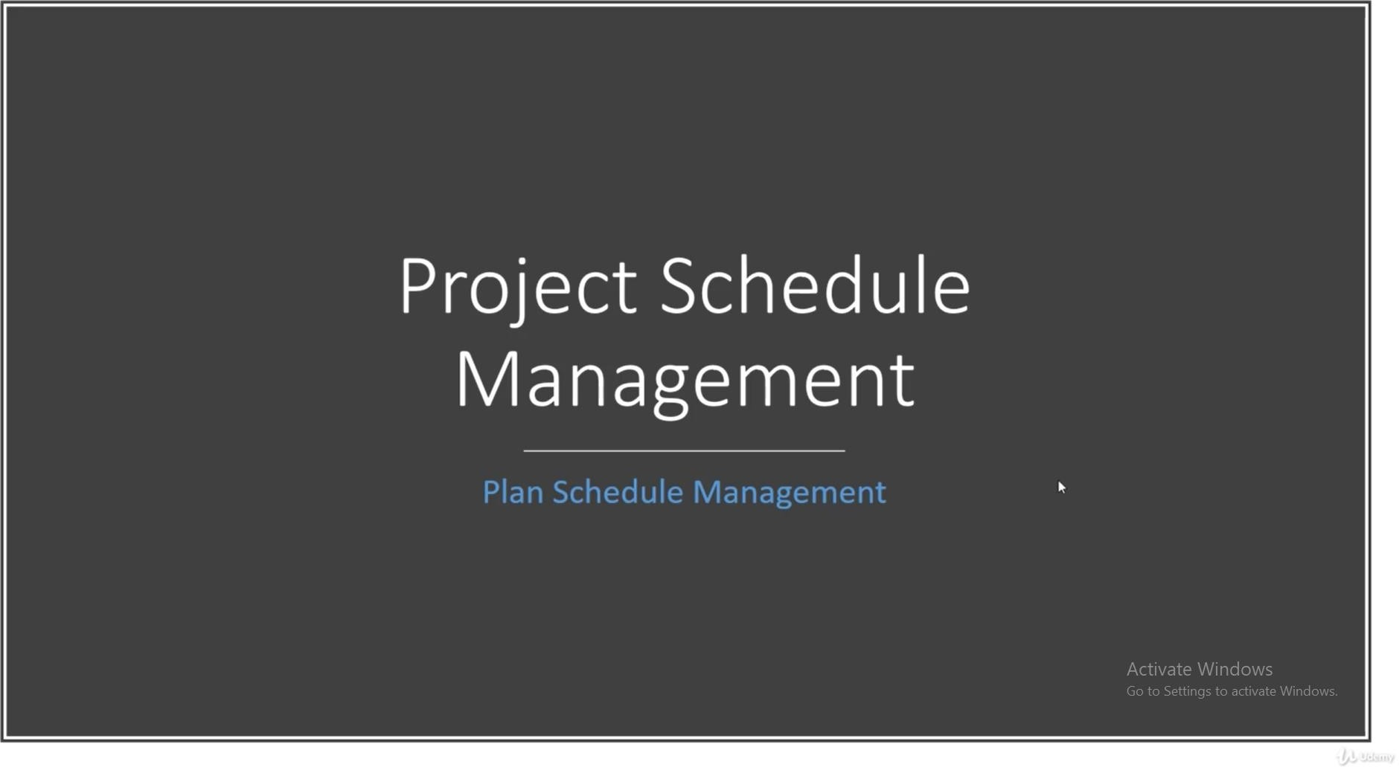

Slide 4
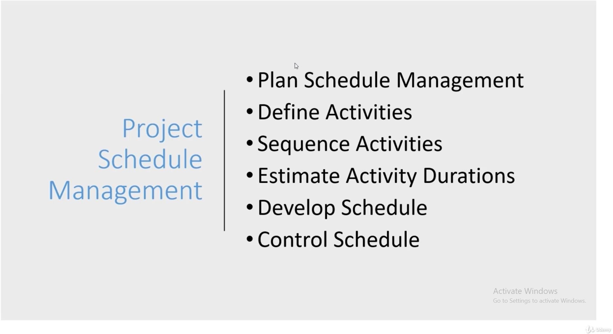

Slide 5
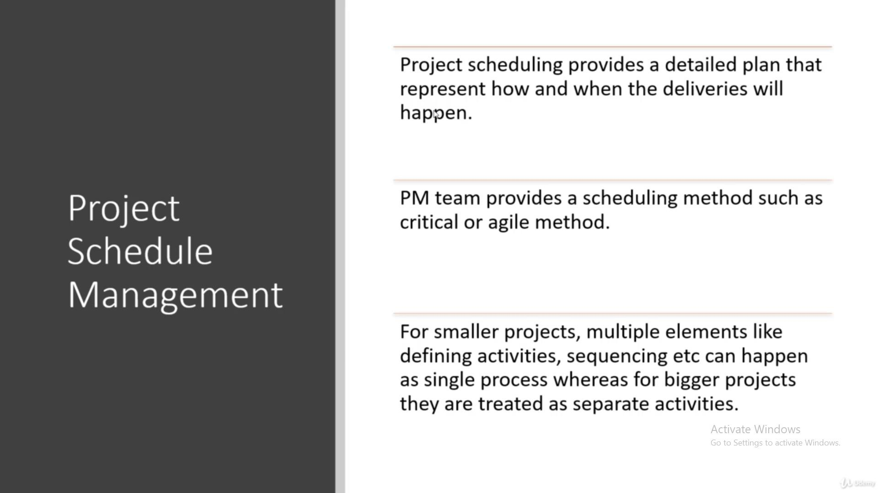

Slide 6
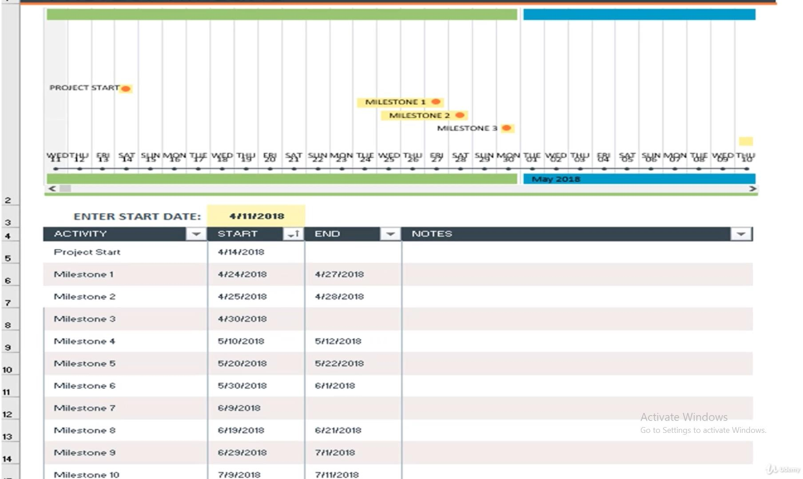

Slide 7
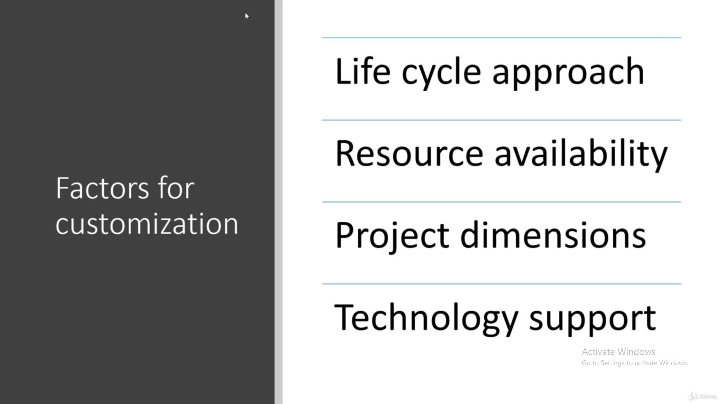

Slide 8
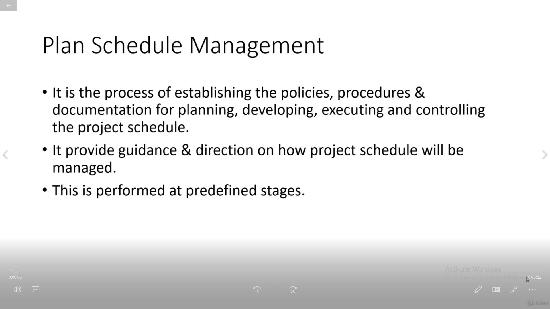

Slide 9
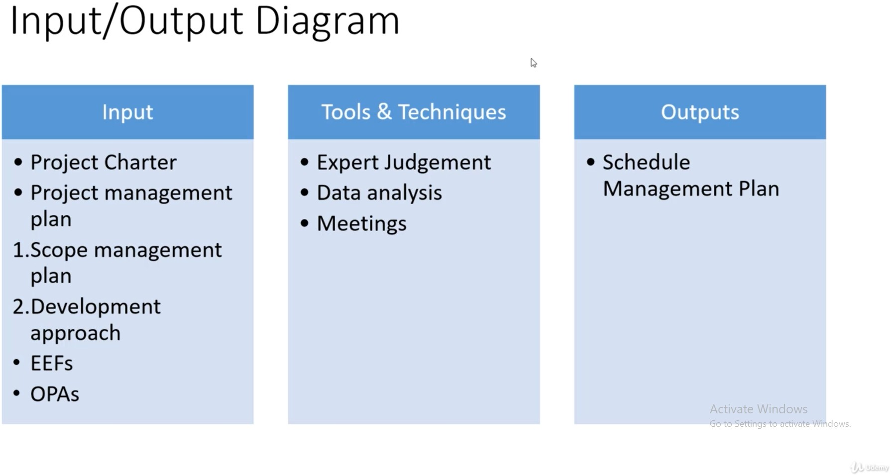

Slide 10
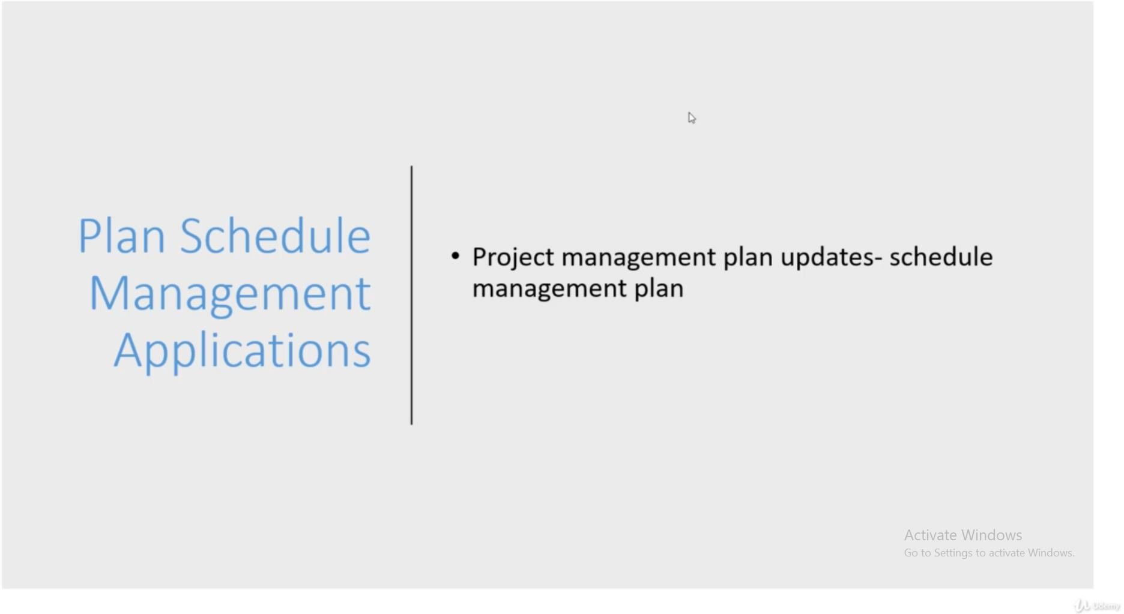

Slide 11
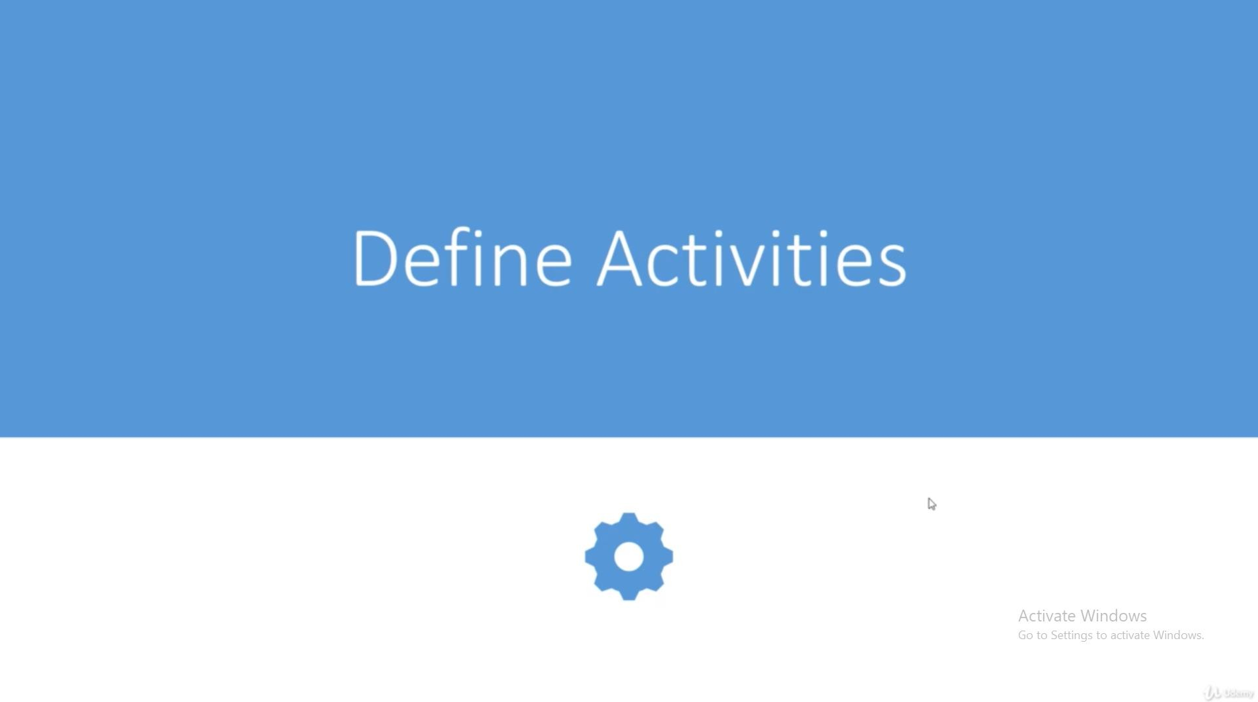

Slide 12
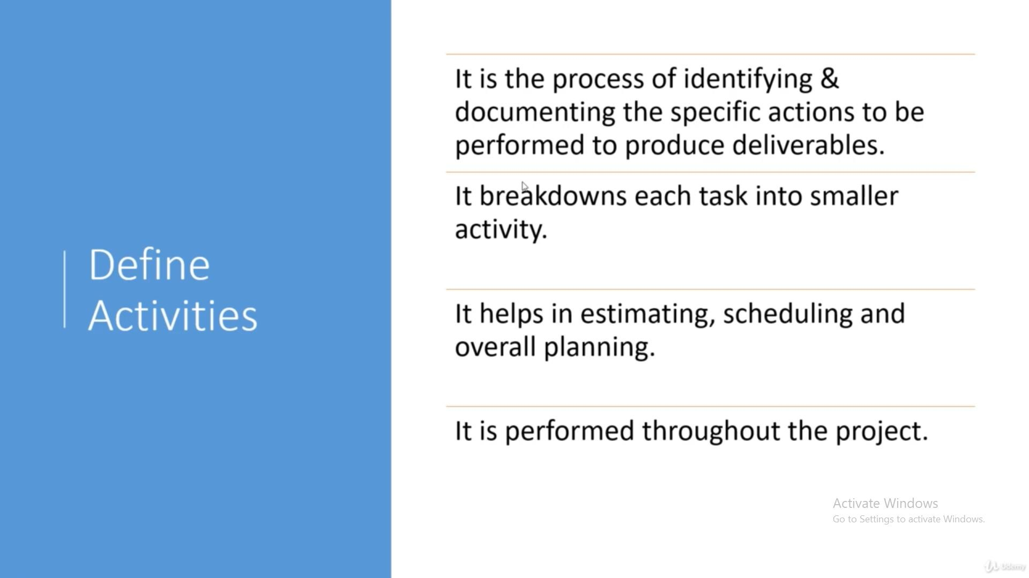

Slide 13
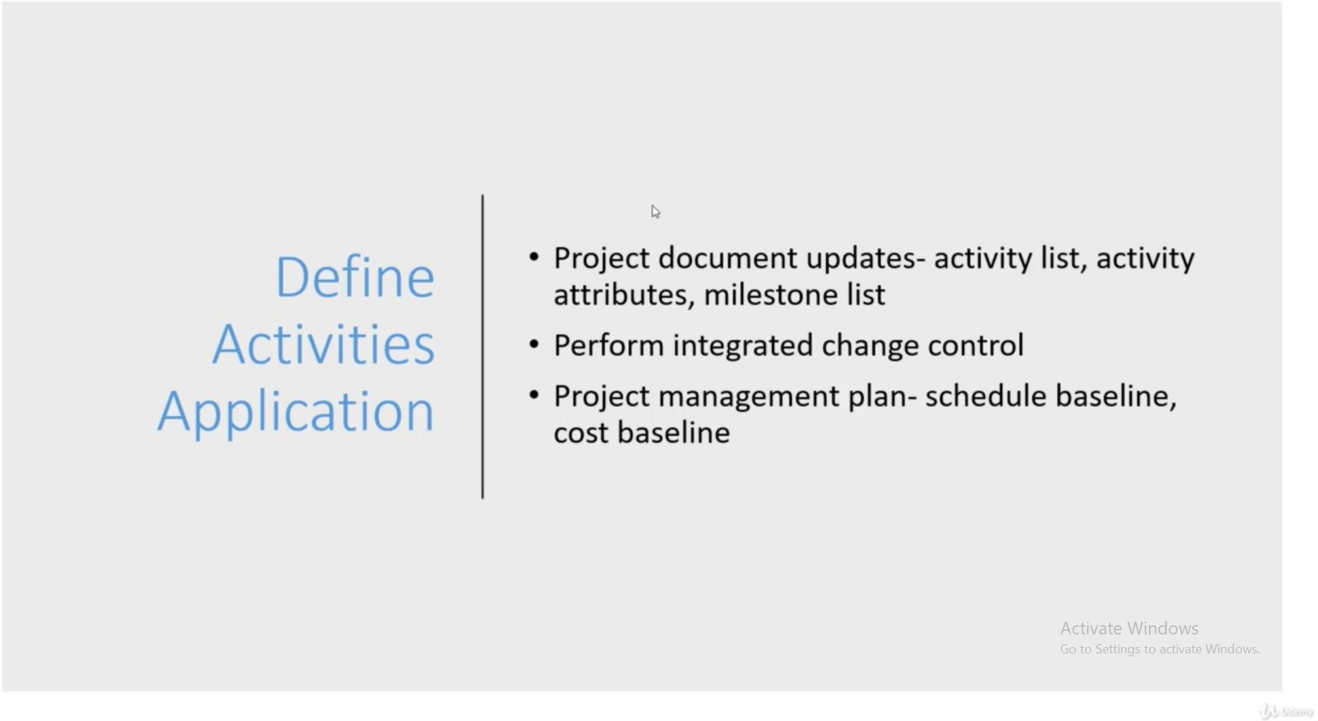

Slide 14
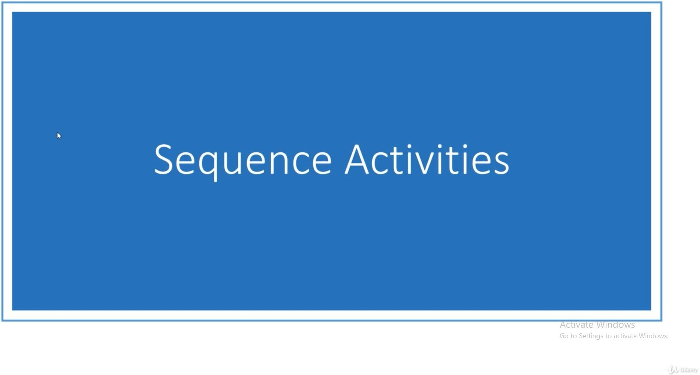

Slide 15
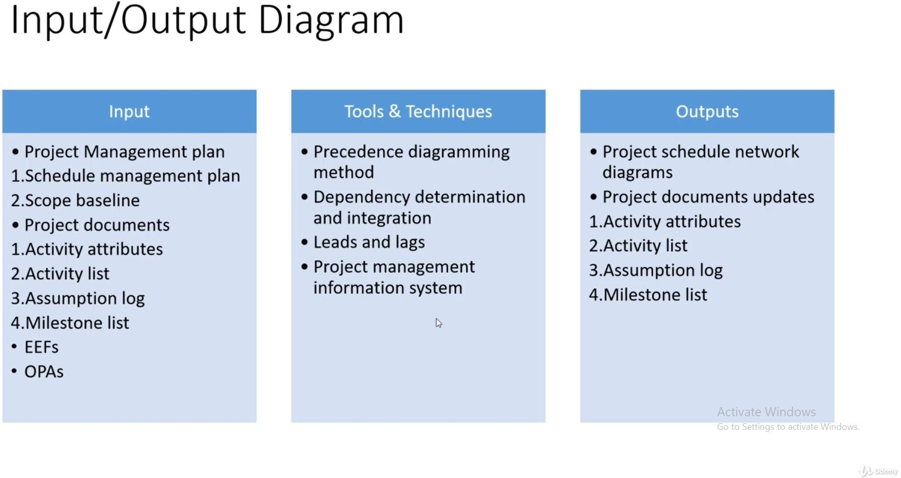

Slide 16
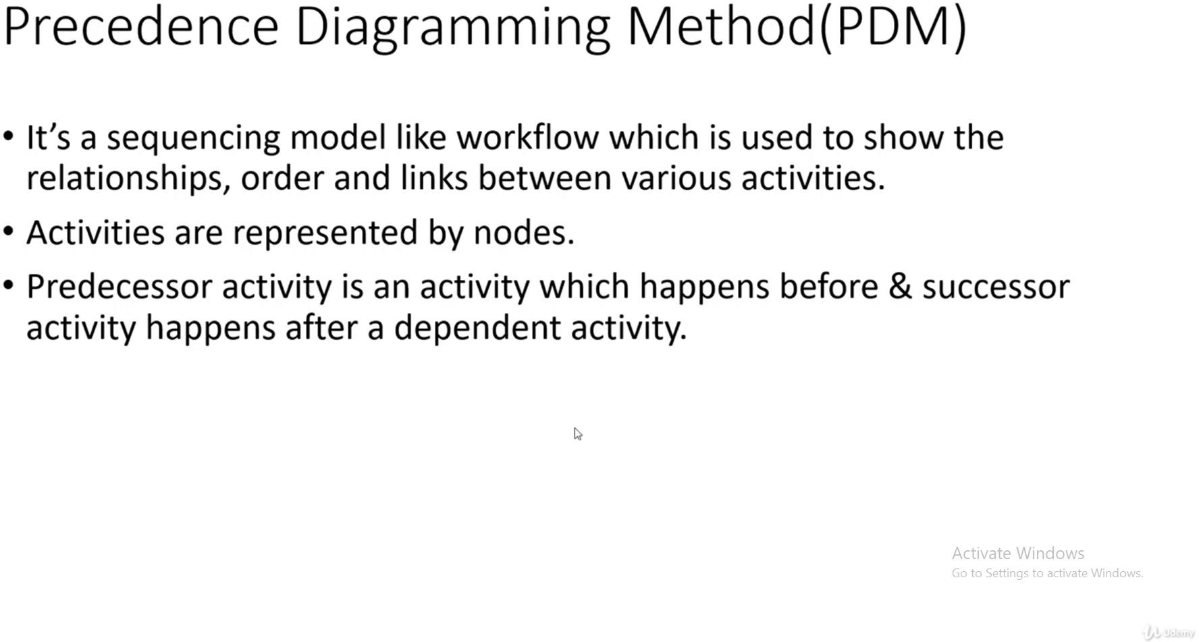

Slide 17
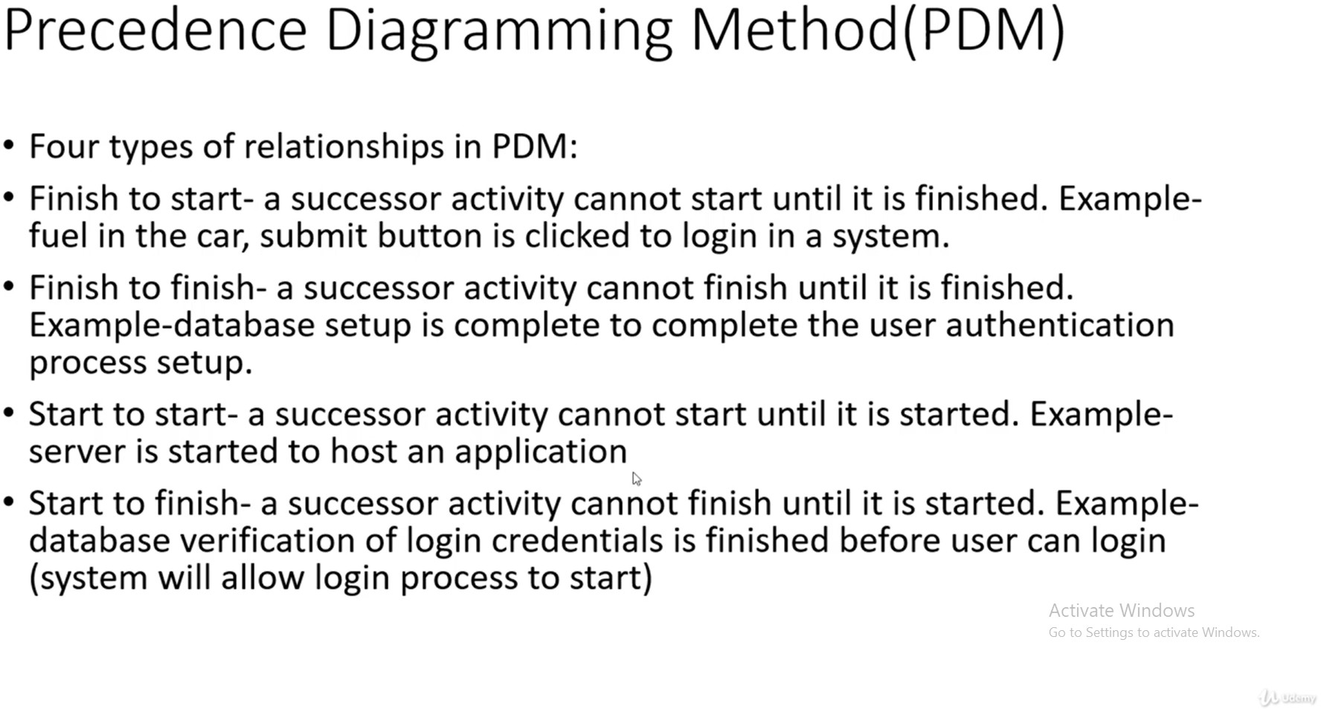

Slide 18
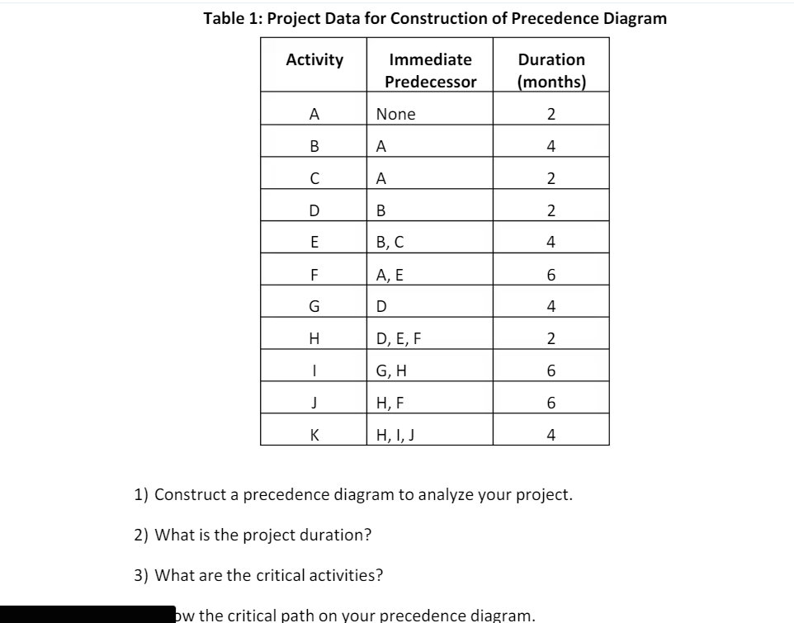
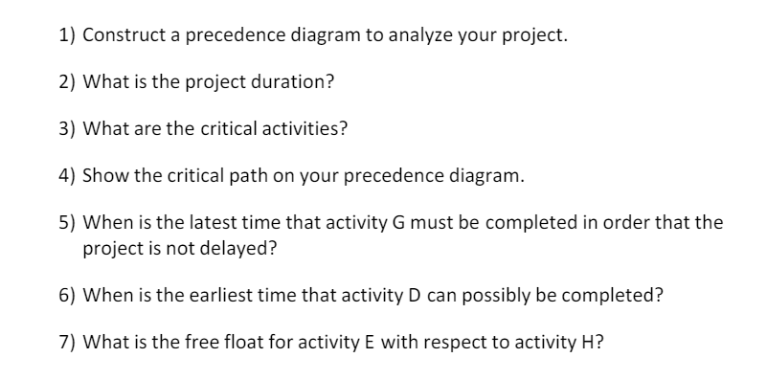

Slide 19
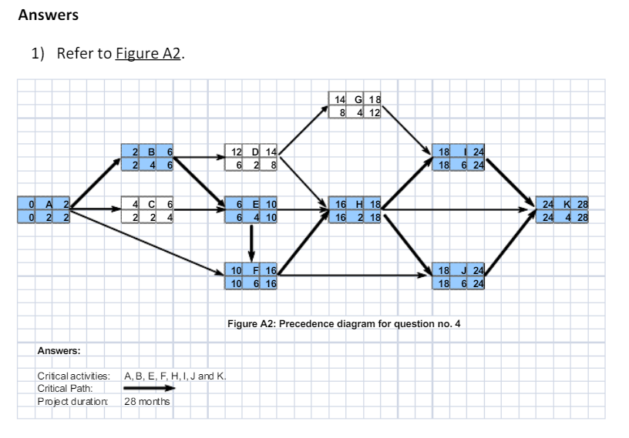
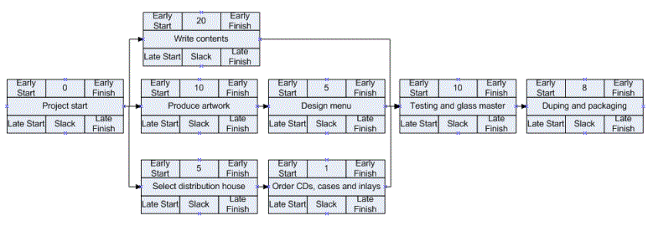
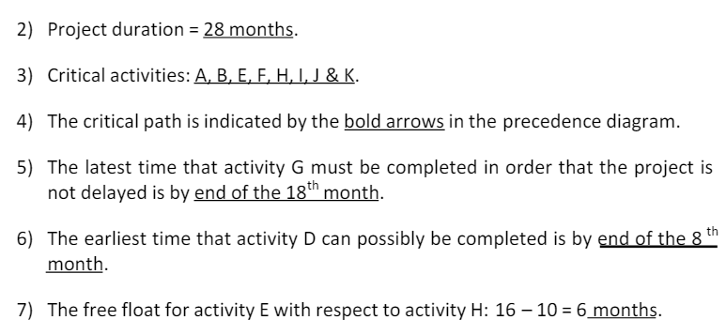

Slide 20
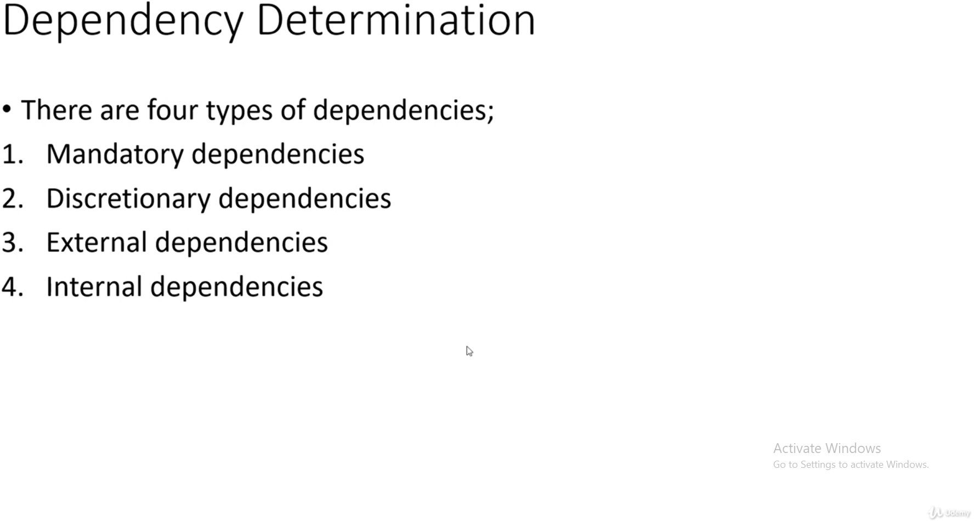

Slide 21
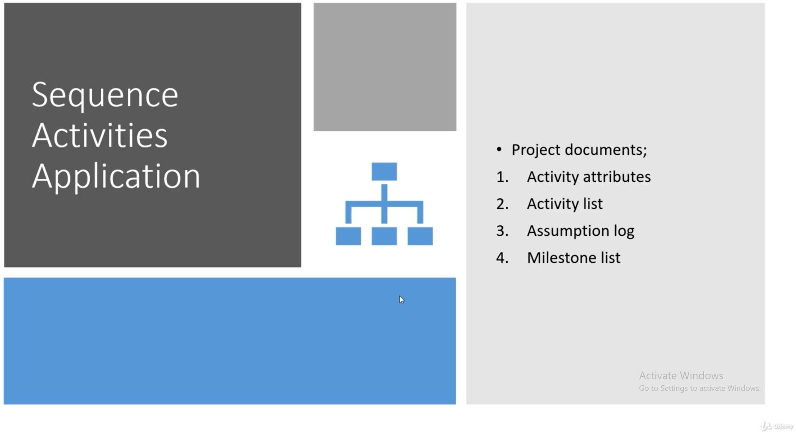

Slide 22
Other Topics that were covered but not mentioned in Slides are:
Precedence Diagramming method
Schedule Estimation techniques like Planning Poker, Wideband Delphi, Three point estimation, Bottom Up estimates, Gantt chart etc.
https://asana.com/resources/project-estimation

Slide 23
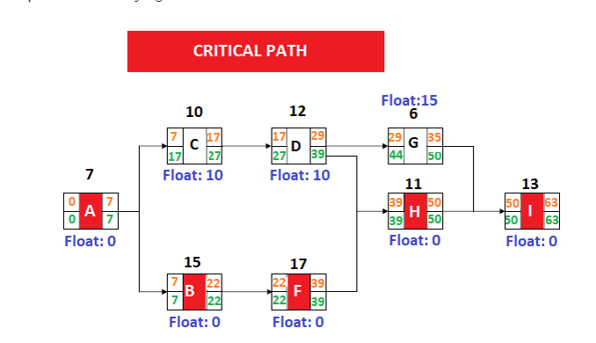
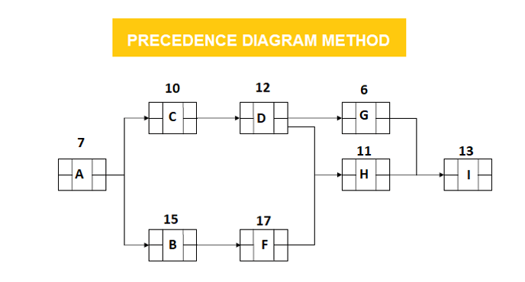
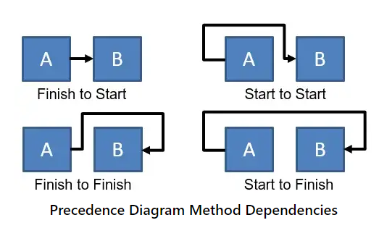
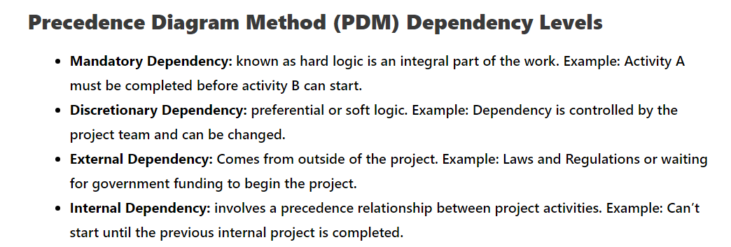
Precedence Diagramming

Slide 24
Planning poker is a consensus-based technique for estimating the effort required to complete a task or user story. It is often used by agile teams, but it can be used by any team that needs to estimate effort.
Planning poker is played by a group of people, typically the team members who will be working on the task or user story being estimated. Each person has a deck of planning poker cards. The cards have different values, such as 0, 1, 2, 3, 5, 8, 13, 20, 40, and 100. These values represent the relative effort required to complete a task, with higher values representing more effort.
To play planning poker, the team first discusses the task or user story being estimated. The product owner or scrum master may provide additional information or answer questions from the team. Once the team has a good understanding of the task, each person selects a planning poker card and places it face down on the table. When everyone is ready, the cards are revealed.
If everyone selected the same card, then that is the team's estimate for the task. However, if there is disagreement, the team discusses their estimates and tries to come to a consensus. The team may ask clarifying questions or discuss different approaches to the task. Once the team has reached a consensus, they select a new planning poker card and repeat the process.
Planning poker is a useful technique for estimating effort because it helps to reduce bias and promote discussion among team members. The anonymity of the cards allows team members to feel comfortable sharing their honest estimates, even if they differ from the estimates of other team members. The discussion that takes place during planning poker helps the team to develop a better understanding of the task and to identify any potential risks or challenges.
Here are some of the benefits of using planning poker in project management:
It helps to improve the accuracy of effort estimates.
It helps to reduce bias and promote discussion among team members.
It helps the team to develop a better understanding of the task and to identify any potential risks or challenges.
It is a fun and engaging way to estimate effort.
Planning poker is a valuable tool for project managers and teams of all sizes. It can help to improve the planning and execution of projects, and it can lead to better outcomes for stakeholders.

Slide 25
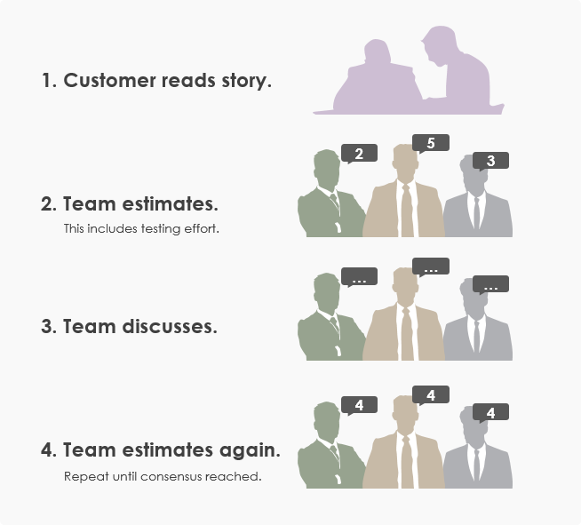

Slide 26
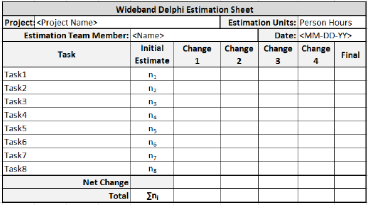
Delphi Method is a structured communication technique, originally developed as a systematic, interactive forecasting method which relies on a panel of experts. The experts answer questionnaires in two or more rounds. After each round, a facilitator provides an anonymous summary of the experts’ forecasts from the previous round with the reasons for their judgments. Experts are then encouraged to revise their earlier answers in light of the replies of other members of the panel.
It is believed that during this process the range of answers will decrease and the group will converge towards the "correct" answer. Finally, the process is stopped after a predefined stop criterion (e.g. number of rounds, achievement of consensus, and stability of results) and the mean or median scores of the final rounds determine the results.
Delphi Method was developed in the 1950-1960s at the RAND Corporation.

Slide 27
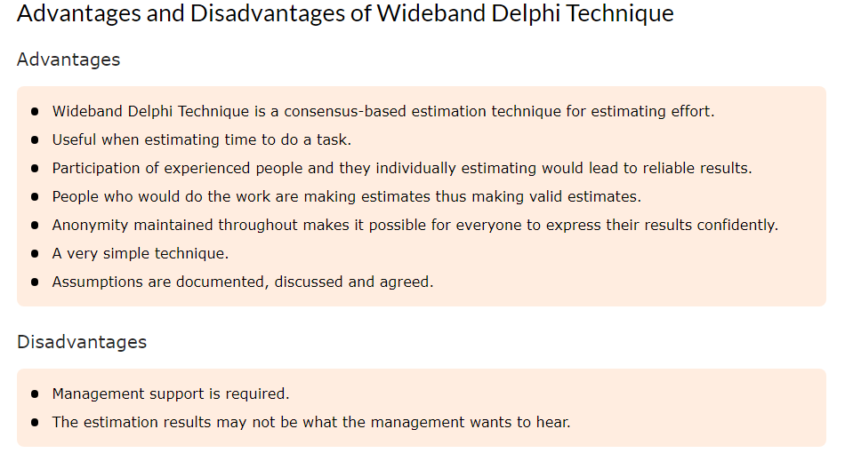

Slide 28
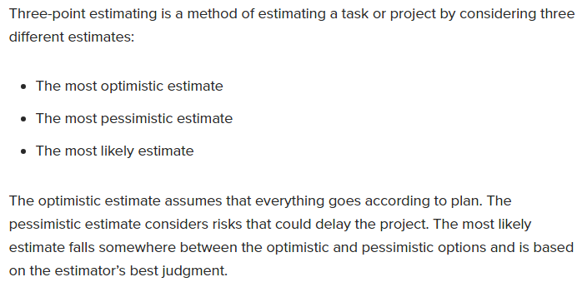
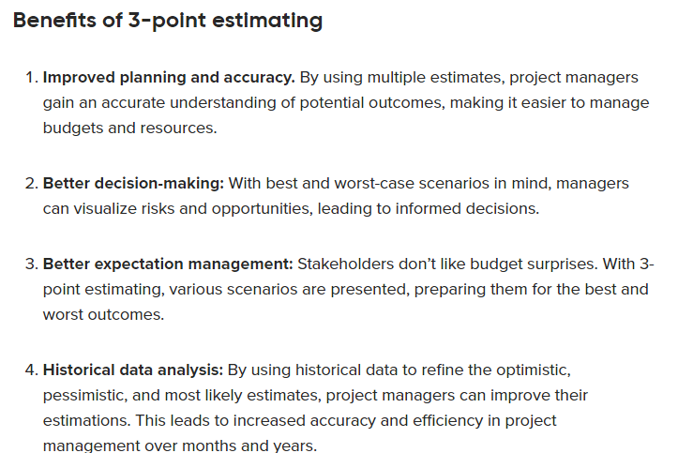
Three point estimation

Slide 29
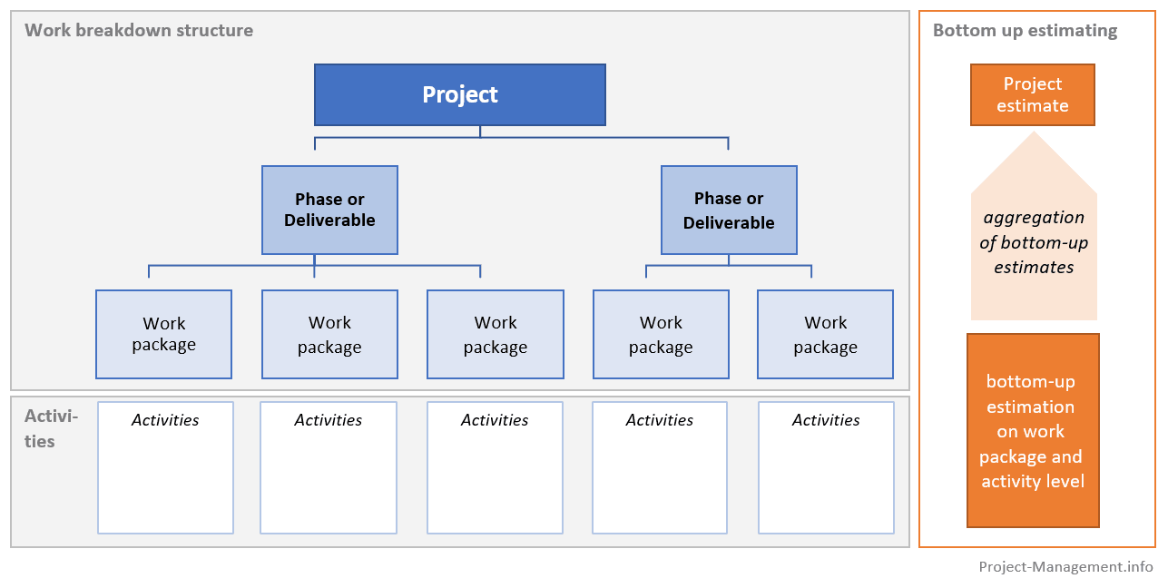
Bottom Up Approach

Slide 30
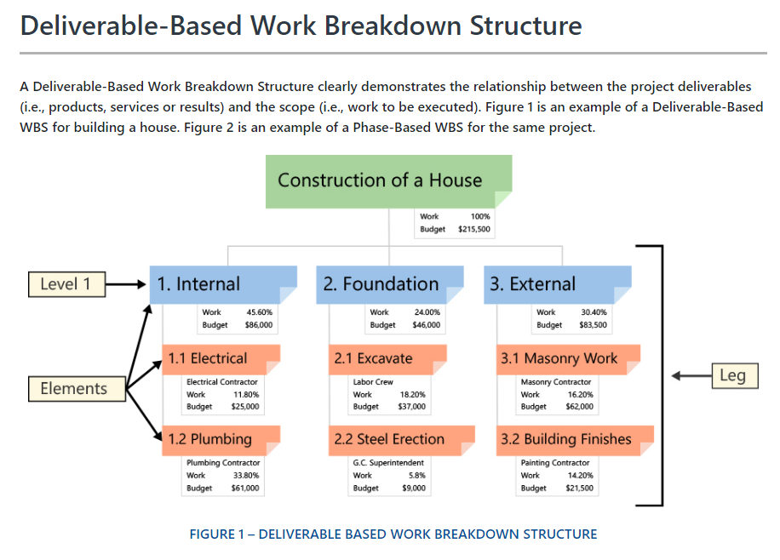

Slide 31
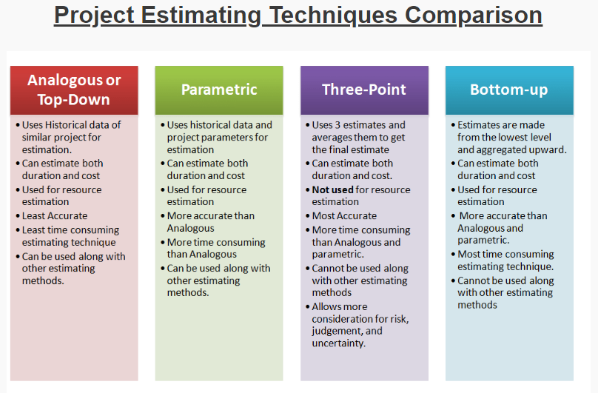

Slide 32
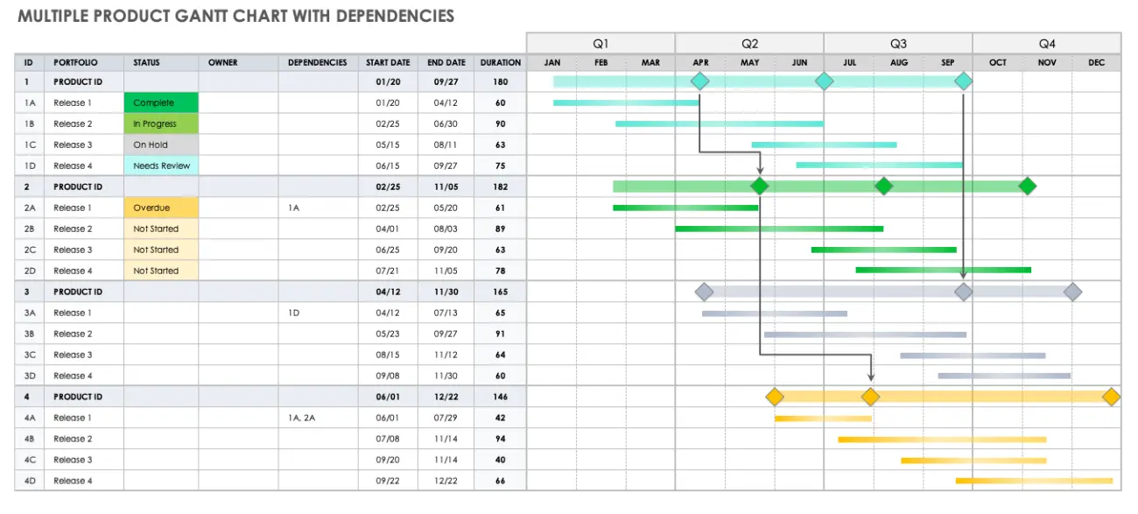
GANTT CHART https://blog.ganttpro.com/en/project-and-task-dependency-types-with-gantt-chart/

Slide 33
https://rebelsguidetopm.com/the-12-principles-of-project-management/
1. *Be a diligent, respectful, and caring steward (see Section 3.1):*
- Explanation: This principle emphasizes responsible and ethical management of resources, showing respect and care for all stakeholders.
- Example: Ensuring that project decisions consider environmental impacts, and respecting privacy and security in software development.
2. *Create a collaborative project team environment (see Section 3.2):*
- Explanation: Promote teamwork, communication, and a positive working environment to enhance productivity and creativity.
- Example: Using agile methodologies that encourage regular team collaboration and feedback during development.
3. *Effectively engage with stakeholders (see Section 3.3):*
- Explanation: Involve and communicate with all relevant parties to understand their needs and expectations.
- Example: Conducting regular meetings with clients and end-users to gather feedback and refine requirements.
4. *Focus on value (see Section 3.4):*
- Explanation: Prioritize activities and features that provide the most value to the end-users and stakeholders.
- Example: Implementing a feature that directly addresses a critical customer need, enhancing the overall product value.
5. *Recognize, evaluate, and respond to system interactions (see Section 3.5):*
- Explanation: Understand and manage the dependencies and interactions within the system.
- Example: Identifying potential conflicts between software modules and resolving them proactively.
6. *Demonstrate leadership behaviors (see Section 3.6):*
- Explanation: Exhibit qualities like decisiveness, accountability, and inspiration to guide the project effectively.
- Example: A project manager taking responsibility for project outcomes and motivating the team through challenges.
try standards and user expectations.

Slide 34
7. *Tailor based on context (see Section 3.7):*
- Explanation: Adapt methodologies and processes according to the specific needs and characteristics of the project.
- Example: Choosing between Agile or Waterfall based on project requirements and constraints.
8. *Build quality into processes and deliverables (see Section 3.8):*
- Explanation: Focus on quality from the start, integrating it into all aspects of the development process.
- Example: Performing regular code reviews and automated testing to identify and fix issues early in the development cycle.
9. *Navigate complexity (see Section 3.9):*
- Explanation: Deal effectively with the intricate nature of software development projects.
- Example: Managing a project with multiple interdependent components and ensuring seamless integration.
10. *Optimize risk responses (see Section 3.10):*
- Explanation: Identify potential risks and develop strategies to minimize or mitigate their impact.
- Example: Creating contingency plans for unexpected delays or technical challenges.
11. *Embrace adaptability and resiliency (see Section 3.11):*
- Explanation: Be open to change and build systems that can withstand challenges and disruptions.
- Example: Adapting to changing user requirements without compromising the stability of the system.
12. *Enable change to achieve the envisioned future state (see Section 3.12):*
- Explanation: Facilitate and manage changes to reach the desired future state of the project.
- Example: Introducing new technologies or features to align with evolving indus

